Slide 1

Cloud Stakeholders

Slide 2
Intended learning outcomes
After completing this topic, you will be able to:
List different cloud stakeholders
Understand the roles of the cloud stakeholders
Be aware of the concerns of the cloud stakeholders

Slide 3
What is a stakeholder
Anyone who has interest in the value cloud computing technology creates
Anyone who is affected positively by it
Anyone who is affected negatively by it

Slide 4
Who are cloud stakeholders?

Slide 5
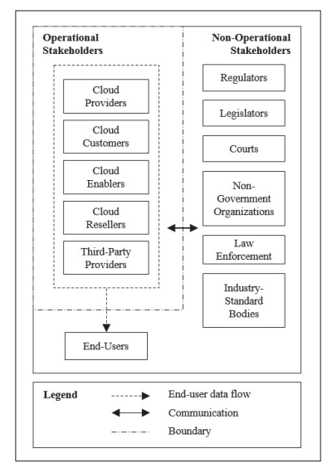
Cloud Stakeholders

Slide 6
Cloud Stakeholders

Slide 7
Operational stakeholders
Stakeholders who perform and conduct cloud operations

Slide 8
Operational stakeholders
Cloud providers
Cloud customers
End-users
Cloud enablers
Cloud resellers
Third-party providers

Slide 9

Operational stakeholders
Cloud providers
Cloud customers
End-users
Cloud enablers
Cloud resellers
Third-party providers

Slide 10
Cloud provider
A cloud service provider is an information technology (IT) company that provides its customers with computing resources over the internet and delivers them on-demand
Popular examples of cloud service providers include:
Amazon Web Services (AWS)
Microsoft Azure
Google Cloud
Alibaba Cloud
IBM Cloud
Salesforce

Slide 11
Cloud provider concerns
Resource utilization
Energy efficiency
Metering
Providing resources
Meet end user requirements
…

Slide 12
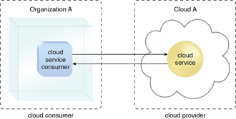
Cloud customer/consumer
A cloud customer (cloud consumer) represents a person or organization that maintains a business relationship with, and uses the service from a cloud provider

Slide 13
Cloud customer/consumer
A cloud customer browses the service catalog from a cloud provider, requests the appropriate service, sets up service contracts with the cloud provider, and uses the service
The cloud consumer may be billed for the service provisioned, and needs to arrange payments accordingly

Slide 14
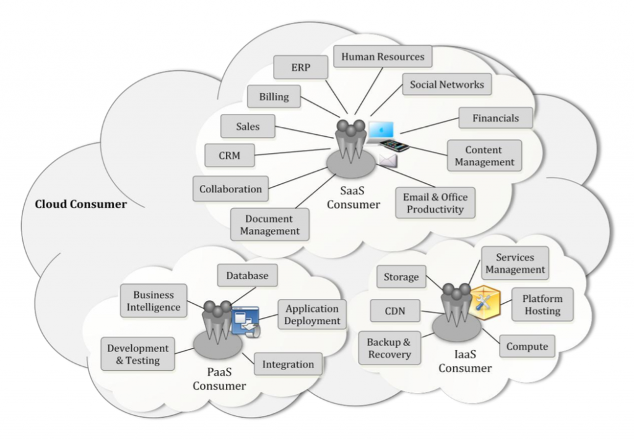
Cloud services available to a cloud consumer

Slide 15
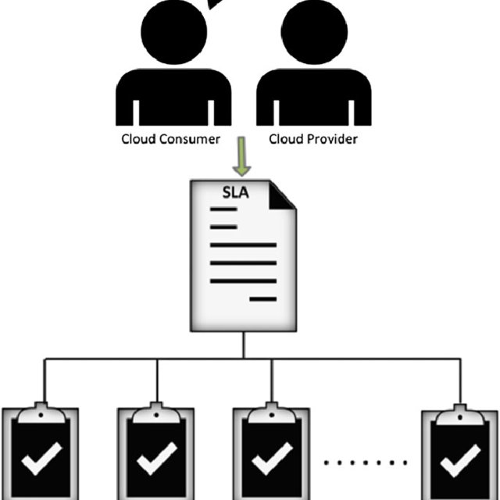
SLA
A cloud customer has a formal contract or arrangement with a cloud provider to use IT resources made available by the cloud provider
A service-level agreement is a commitment between a service provider and a client

Slide 16
SLA
Cloud consumers need SLAs to specify the technical performance requirements fulfilled by a cloud provider
quality of service
security
remedies for performance failures
A cloud provider may also list in the SLAs limitations and obligations that cloud consumers must accept
Typically, a cloud provider’s pricing policy and SLAs are non-negotiable, unless the customer expects heavy usage and might be able to negotiate for better contracts.

Slide 17
SLA Example
CI VM Hosting SLA - Feb 2020.pdf (columbia.edu)
Analyze the SLA thoroughly. Identify key terms, conditions, and performance metrics specified within the SLA.
Explain how the terms outlined in the SLA influence customer expectations. Consider aspects like uptime, data security, support response times, and other relevant factors.
Assess the potential impact of the SLA on service performance. Does the SLA guarantee a certain level of service availability, performance, or responsiveness? Discuss how these guarantees may affect the customer's experience.

Slide 18
SLA questions
In your analysis, you can study if you can find the answers to these questions in this SLA:
Service Availability: What is the guaranteed uptime percentage for the service? For example, "What is the minimum uptime percentage specified in the SLA?"
Response Times: What are the response time expectations for resolving issues or answering customer inquiries? For example, "What is the maximum response time for critical support requests?"
Penalties and Remedies: What penalties or remedies are outlined in the SLA for service provider failures? For example, "What are the penalties if the service provider fails to meet the agreed-upon uptime?"
Service Metrics: What specific metrics are used to measure service quality and performance? For example, "What key performance indicators (KPIs) are included in the SLA?"
Escalation Procedures: What are the procedures for escalating service issues or disputes? For example, "How does the SLA address the escalation of service problems?"
Termination Clauses: Under what circumstances can the customer or service provider terminate the agreement? For example, "What are the conditions for early termination of the SLA?"
Service Reporting: How and when are service performance reports provided to the customer? For example, "When will the service provider deliver performance reports to the customer?"
Service Maintenance: What provisions are there for planned maintenance and downtime? For example, "How does the SLA handle scheduled maintenance and downtime?"
Data Security and Privacy: What security and privacy measures are outlined to protect customer data? For example, "How does the SLA address data security and privacy concerns?"
Force Majeure: How does the SLA handle unforeseen circumstances or "force majeure" events that could impact service delivery? For example, "What is the provision for force majeure in the SLA?"
Dispute Resolution: What mechanisms are in place for resolving disputes between the customer and the service provider? For example, "How does the SLA address dispute resolution?"
Renewal and Review: How often is the SLA reviewed, and what is the process for renewing it? For example, "What is the duration of the initial SLA, and how is it renewed?"
Geographic Coverage: Does the SLA specify the geographic areas where the service will be provided? For example, "Is there a geographic scope defined in the SLA?"
Pricing and Payment Terms: What are the pricing details and payment terms outlined in the SLA? For example, "How is pricing structured, and when are payments due?"
Service Provider Responsibilities: What are the specific responsibilities of the service provider, including any obligations to provide support or training?

Slide 19
Operational stakeholders
Cloud providers
Cloud customers
End-users
Cloud enablers
Cloud resellers
Third-party providers

Slide 20
Operational stakeholders
Cloud providers
Cloud customers
End-users
Cloud enablers
Cloud resellers
Third-party providers

Slide 21
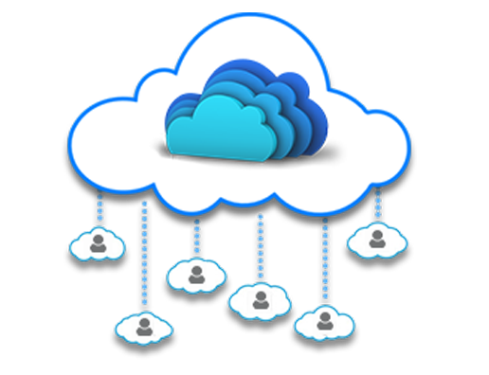
End-user
People who simply use cloud services on an everyday basis
employees inside a company who are end users of the company’s cloud services
general public, connecting to cloud services designed for massive public consumption
Most end users have no special technical skills

Slide 22
End user concerns
Security
Privacy
High availability
Ease of use
…

Slide 23
Operational stakeholders
Cloud providers
Cloud customers
End-users
Cloud enablers
Cloud resellers
Third-party providers

Slide 24
Example - Rain Classroom - 雨课堂
Rain Classroom is a cloud computing tool, which is jointly developed by Tsinghua University and XueTangX.
HITSZ purchased a school membership that allows HITSZ staff and students to access Rain Classroom functions
In this scenario
Who is cloud provider?
Who is cloud customer?
Who is cloud end-user?

Slide 25
Example - Rain Classroom - 雨课堂
Rain Classroom is a cloud computing tool, which is jointly developed by Tsinghua University and XueTangX.
HITSZ purchased a school membership that allows HITSZ staff and students to access Rain Classroom functions
In this scenario
Who is cloud provider?
Who is cloud customer?
Who is cloud end-user?

Slide 26
Example - Rain Classroom - 雨课堂
Rain Classroom is a cloud computing tool, which is jointly developed by Tsinghua University and XueTangX.
HITSZ purchased a school membership that allows HITSZ staff and students to access Rain Classroom functions
In this scenario
Who is cloud provider?
Who is cloud customer?
Who is cloud end-user?

Slide 27
Example - Rain Classroom - 雨课堂
Rain Classroom is a cloud computing tool, which is jointly developed by Tsinghua University and XueTangX.
HITSZ purchased a school membership that allows HITSZ staff and students to access Rain Classroom functions
In this scenario
Who is cloud provider?
Who is cloud customer?
Who is cloud end-user?

Slide 28
Operational stakeholders
Cloud providers
Cloud customers
End-users
Cloud enablers
Cloud resellers
Third-party providers

Slide 29
Cloud enabler
Cloud enablers are information technology (IT) firms that create hardware, software, storage devices, networking equipment, and other related cloud environment components

Slide 30
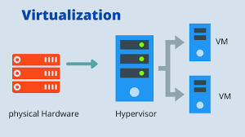
Cloud enabler example
An organization that manufactures virtualization hypervisors that enable virtual machines (VMs) is a cloud enabler
A hypervisor is hardware, software, or firmware capable of creating virtual machines and then managing and allocating resources to them

Slide 31
Cloud enabler vs cloud provider
A cloud enabler is different from a cloud service provider
Cloud service providers use the technologies built by cloud enablers to deliver cloud-based services to end-users

Slide 32
Why are cloud enablers important?
Cloud enablers serve as the backbone for cloud products and services offered by a cloud provider
Developing a scalable, reliable, and robust cloud computing service is complex and requires many technical skills and hard work
Let a company build, deploy, integrate, and deliver cloud computing solutions

Slide 33
Why are cloud enablers important?
Cloud enablers make it possible for the cloud customers to move their resources to the cloud
Cloud enablers play a critical role in coming up with cloud strategies, service selection, and cloud app development and infrastructure establishment
A cloud enabler is a huge part of building, deploying, integrating, and delivering cloud computing solutions

Slide 34
Cloud reseller
A cloud reseller is a service provider who buys cloud computing products and services from major providers like AWS or Google, which they then resell to their own customers

Slide 35
Cloud reseller
A cloud computing reseller acts as a valued added reseller (VAR) when they combine and/or complement the cloud product/service with additional value or functionality.

Slide 36
Cloud reseller - example
A cloud computing reseller combines their photo editing software with cloud provider’s storage service to enhance the value of software product

Slide 37
Third-party providers
A company that provides cloud services to another company without a contract
When contracting for cloud-computing services, one challenge is that there may be more parties involved than the cloud customer and the cloud provider

Slide 38



Third-party providers - example
A cloud user uses services of a SaaS provider Dropbox

Slide 39
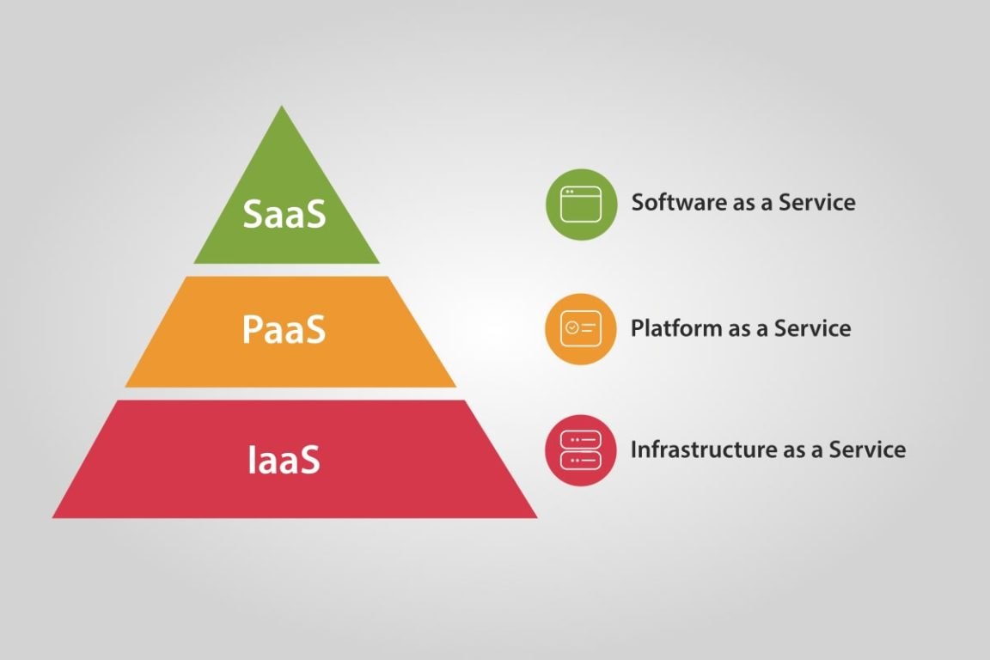


Third-party providers - example
Dropbox is running its service in the data center of a third-party IaaS vendor, Amazon Web Services

Slide 40
Third-party providers - example
In this scenario
Dropbox is a service provider
AWS is a third-party provider

Slide 41

Third-party providers - example
This can increase the complexity of a cloud-computing contract, especially in determining which provider is responsible for which action

Slide 42
Third-party provider challenges
The introduction of third parties can increase risk
It's essential for potential cloud customers to identify third parties before adopting a cloud service, thoroughly understand their roles and ensure that their responsibilities are effectively addressed in the contract

Slide 43
Cloud Stakeholders

Slide 44
Cloud Stakeholders

Slide 45
Developing laws for cloud computing
Protecting the customers' and service provider's rights has become quite challenging for Cloud Computing
Different countries have their own specific jurisdiction, laws, and regulations.
There are diverse stakeholders that ensure the development of efficient and fair laws for both the customers and service providers

Slide 46
Legal issues in cloud computing
Legal issues that can arise “in the cloud” include
liability for copyright infringement
data breaches
security violations, privacy violations
data loss, data management
hacking, cybersecurity
…
There are diverse stakeholders that ensure that legal standards, regulations, and norms relating to cloud computing are being developed

Slide 47
Highly regulated industries
Highly regulated industries face specific industry regulatory requirements, standards and laws
Healthcare
Finance
Government
…
There are diverse stakeholders that ensure that organizations operating within these industries are compliant with the requirements

Slide 48
Summary

Slide 49
Cloud Computing Standardization and Reference Architecture

Slide 50
Cloud Computing Standardization and Reference Architecture
Standardization of cloud computing
Cloud Computing Reference Architecture
Cloud computing standards and laws in China
Cloud computing adoption issues

Slide 51
Standardization of cloud computing

Slide 52
Standardization
The implementation of standards in industry

Slide 53
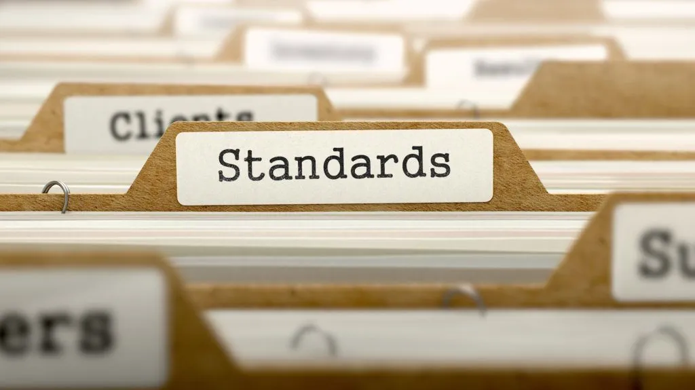
Standardization – definition (1)
The implementation of standards in industry

Slide 54
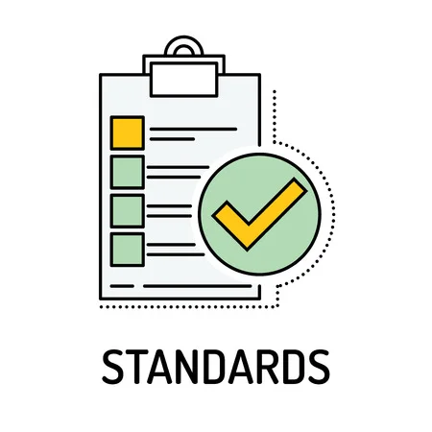
Standard
A standard is a repeatable, harmonised, agreed and documented way of doing something
Standards contain technical specifications or other precise criteria designed to be used consistently as a rule, guideline, or definition

Slide 55
Standard
As defined by ISO
“A standard is a document, established by a consensus of subject matter experts and approved by a recognized body that provides guidance on the design, use or performance of materials, products, processes, services, systems or persons”.

Slide 56
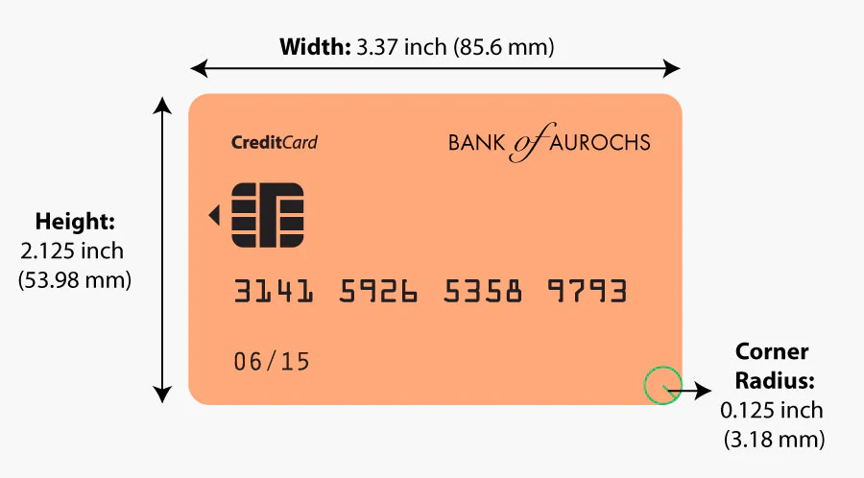

Standard - example
The size of payment cards (ATM cards, credit cards, debit cards, etc.) is 85.60 by 53.98 millimetres and rounded corners with a radius of 2.88–3.48 millimetres
conforming to the ISO/IEC 7810 ID-1 standard “Identification cards — Physical characteristics”

Slide 57
Standardization – definition (2)
The process of creating protocols to guide the creation of goods or services based on the consensus of all the relevant parties in the industry

Slide 58
Standardization purpose (1)
The standards ensure that goods or services produced in a specific industry come with consistent quality and are equivalent to other comparable products or services in the same industry

Slide 59
Standardization purpose (2)
Standardization helps in ensuring the safety, interoperability, and compatibility of goods produced

Slide 60
Industry standardization examples
Parties | Mutual gains | Problem | Solution
Mechanical industry companies | Suppliers interchange, stock gains, etc. | Screw thread compatibility | Screw thread standard specifications
Pharmaceutical industry and medic community | Enable medical prescriptions, suppliers interchange, etc. | Drug uniformity | Drug standard specifications
Banks and specialized payment cards companies | Enable Credit card holder to pay a merchant for goods and services | Credit card uniformity | Credit card technical specifications

Slide 61
Who creates standards
Parties involved in the standardization processes:
Users
Interest groups
Corporations
Industrial or manufacturing associations
Professional societies
Governments
Standards organizations
…

Slide 62
Who creates standards
Parties involved in the standardization processes:
Users
Interest groups
Corporations
Industrial or manufacturing associations
Professional societies
Governments
Standards organizations
…

Slide 63
Standards organization
A standards organization / standards body / standards developing organization (SDO) / standards setting organization (SSO)
An organization whose primary function is developing, coordinating, promulgating, revising, amending, reissuing, interpreting, or otherwise contributing to the usefulness of technical standards

Slide 64
Formal vs de facto standards
Formal standard
A formal document that establishes uniform engineering or technical criteria, methods, processes, and practices
has been approved by a standards setting organization
de jure standard - standard mandated by legal requirements
De facto standard
A custom, convention, company product, corporate standard, and so forth that becomes generally accepted and dominant
Has achieved widespread use and acceptance – often without being approved by any standards organization (or receiving such approval only after it already has achieved widespread use)
Example: Microsoft Word DOC - due to the market dominance of Word, it is supported by all office applications that intend to compete with it

Slide 65
Technical standard
A technical standard is an established norm or requirement for a repeatable technical task which is applied to a common and repeated use of rules, conditions, guidelines or characteristics for products or related processes and production methods, and related management systems practices

Slide 66
Technical standard
A technical standard includes
definition of terms
classification of components
delineation of procedures
specification of dimensions, materials, performance, designs, or operations
measurement of quality and quantity in describing materials processes, products, systems, services, or practices
test methods and sampling procedures
measurements of size or strength

Slide 67
Types of technical standards
A standard specification
A standard test method
A standard practice/procedure
A standard guide
A standard definition
Standard units

Slide 68
Standard specification
An explicit set of requirements for an item, material, component, system or service
It is often used to formalize the technical aspects of a procurement agreement or contract
For example, there may be a specification for a turbine blade for a jet engine that defines the exact material and performance requirements

Slide 69
Standard test method
A definitive procedure that produces a test result
It may involve making a careful personal observation or conducting a highly technical measurement
For example, a physical property of a material is often affected by the precise method of testing: any reference to the property should therefore reference the test method used

Slide 70
Standard practice/procedure
A set of instructions for performing operations or functions
For example, there are detailed standard operating procedures for operation of a nuclear power plant

Slide 71
Standard guide
General information or options that do not require a specific course of action

Slide 72
Standard definition
Formally established terminology

Slide 73
Standard units
In physics and applied mathematics - commonly accepted measurements of physical quantities

Slide 74
Standards classification
Voluntary consensus standards
Industry standards/private standards
Government standards

Slide 75
Voluntary consensus standards
Standards developed or adopted by voluntary consensus standards bodies
Domestic (national)
Regional
International

Slide 76
Industry standards/ private standards
Standards developed in the private sector but not in the full consensus process, typically requiring a financial contribution
Consortia standards
Civil society standards
Company-specific standards

Slide 77
Government standards
Standards developed by the government for its own uses

Slide 78
Standards availability
Technical standards may exist as:
Public documents on the internet, public library, etc. (Some technical standards may be found at a major central library or at the library of a good technical university)
Published documents available for purchase
Private documents owned by an organization or corporation, used and circulated as the owner determines necessary or useful
Documents publicly available under intellectual property (copyright, etc.)
Closed or controlled documents that contain trade secrets or classified information

Slide 79
International standard
An international standard is a technical standard developed by one or more international standards organizations
International standards are available for consideration and use worldwide

Slide 80
Role of international standards
International standards are essential for eliminating technical barriers to trade

Slide 81
Technical barriers to trade (1)
Technical barriers in international commerce caused by differences among technical regulations and standards developed independently and separately by each nation, national standards organization, or business
Technical barriers arise when different groups come together, each with a large user base, doing some well established thing that between them is mutually incompatible

Slide 82
Technical barriers to trade (2)
Any regulation, standard or procedure that could make exporting goods to another country more difficult
Example: testing or certification procedures
a Canadian entrepreneur may have a product certified by the Canadian Standards Association (CSA), but that certification may not be valid in other countries
this forces the company to recertify the product in the country where they wish to sell it—a potentially costly and time-consuming procedure.

Slide 83
Role of international standards
International standards are essential for eliminating technical barriers to trade
They allow for services and products to be made available to others regardless of the country where they originated

Slide 84



International standard organizations
ISO
International Organization for Standardization
ITU
International Telecommunication Union
IEC
International Electrotechnical Commission

Slide 85

World Standards Cooperation alliance
Together, these three organizations have formed the World Standards Cooperation alliance

Slide 86
ISO - The International Organization for Standardization
An international standard development organization
It works in 167 countries
Develops and publishes standardization in all technical and nontechnical fields other than electrical and electronic engineering
Electronic engineering standards are responsibility of IEC - International Electrotechnical Commission

Slide 87
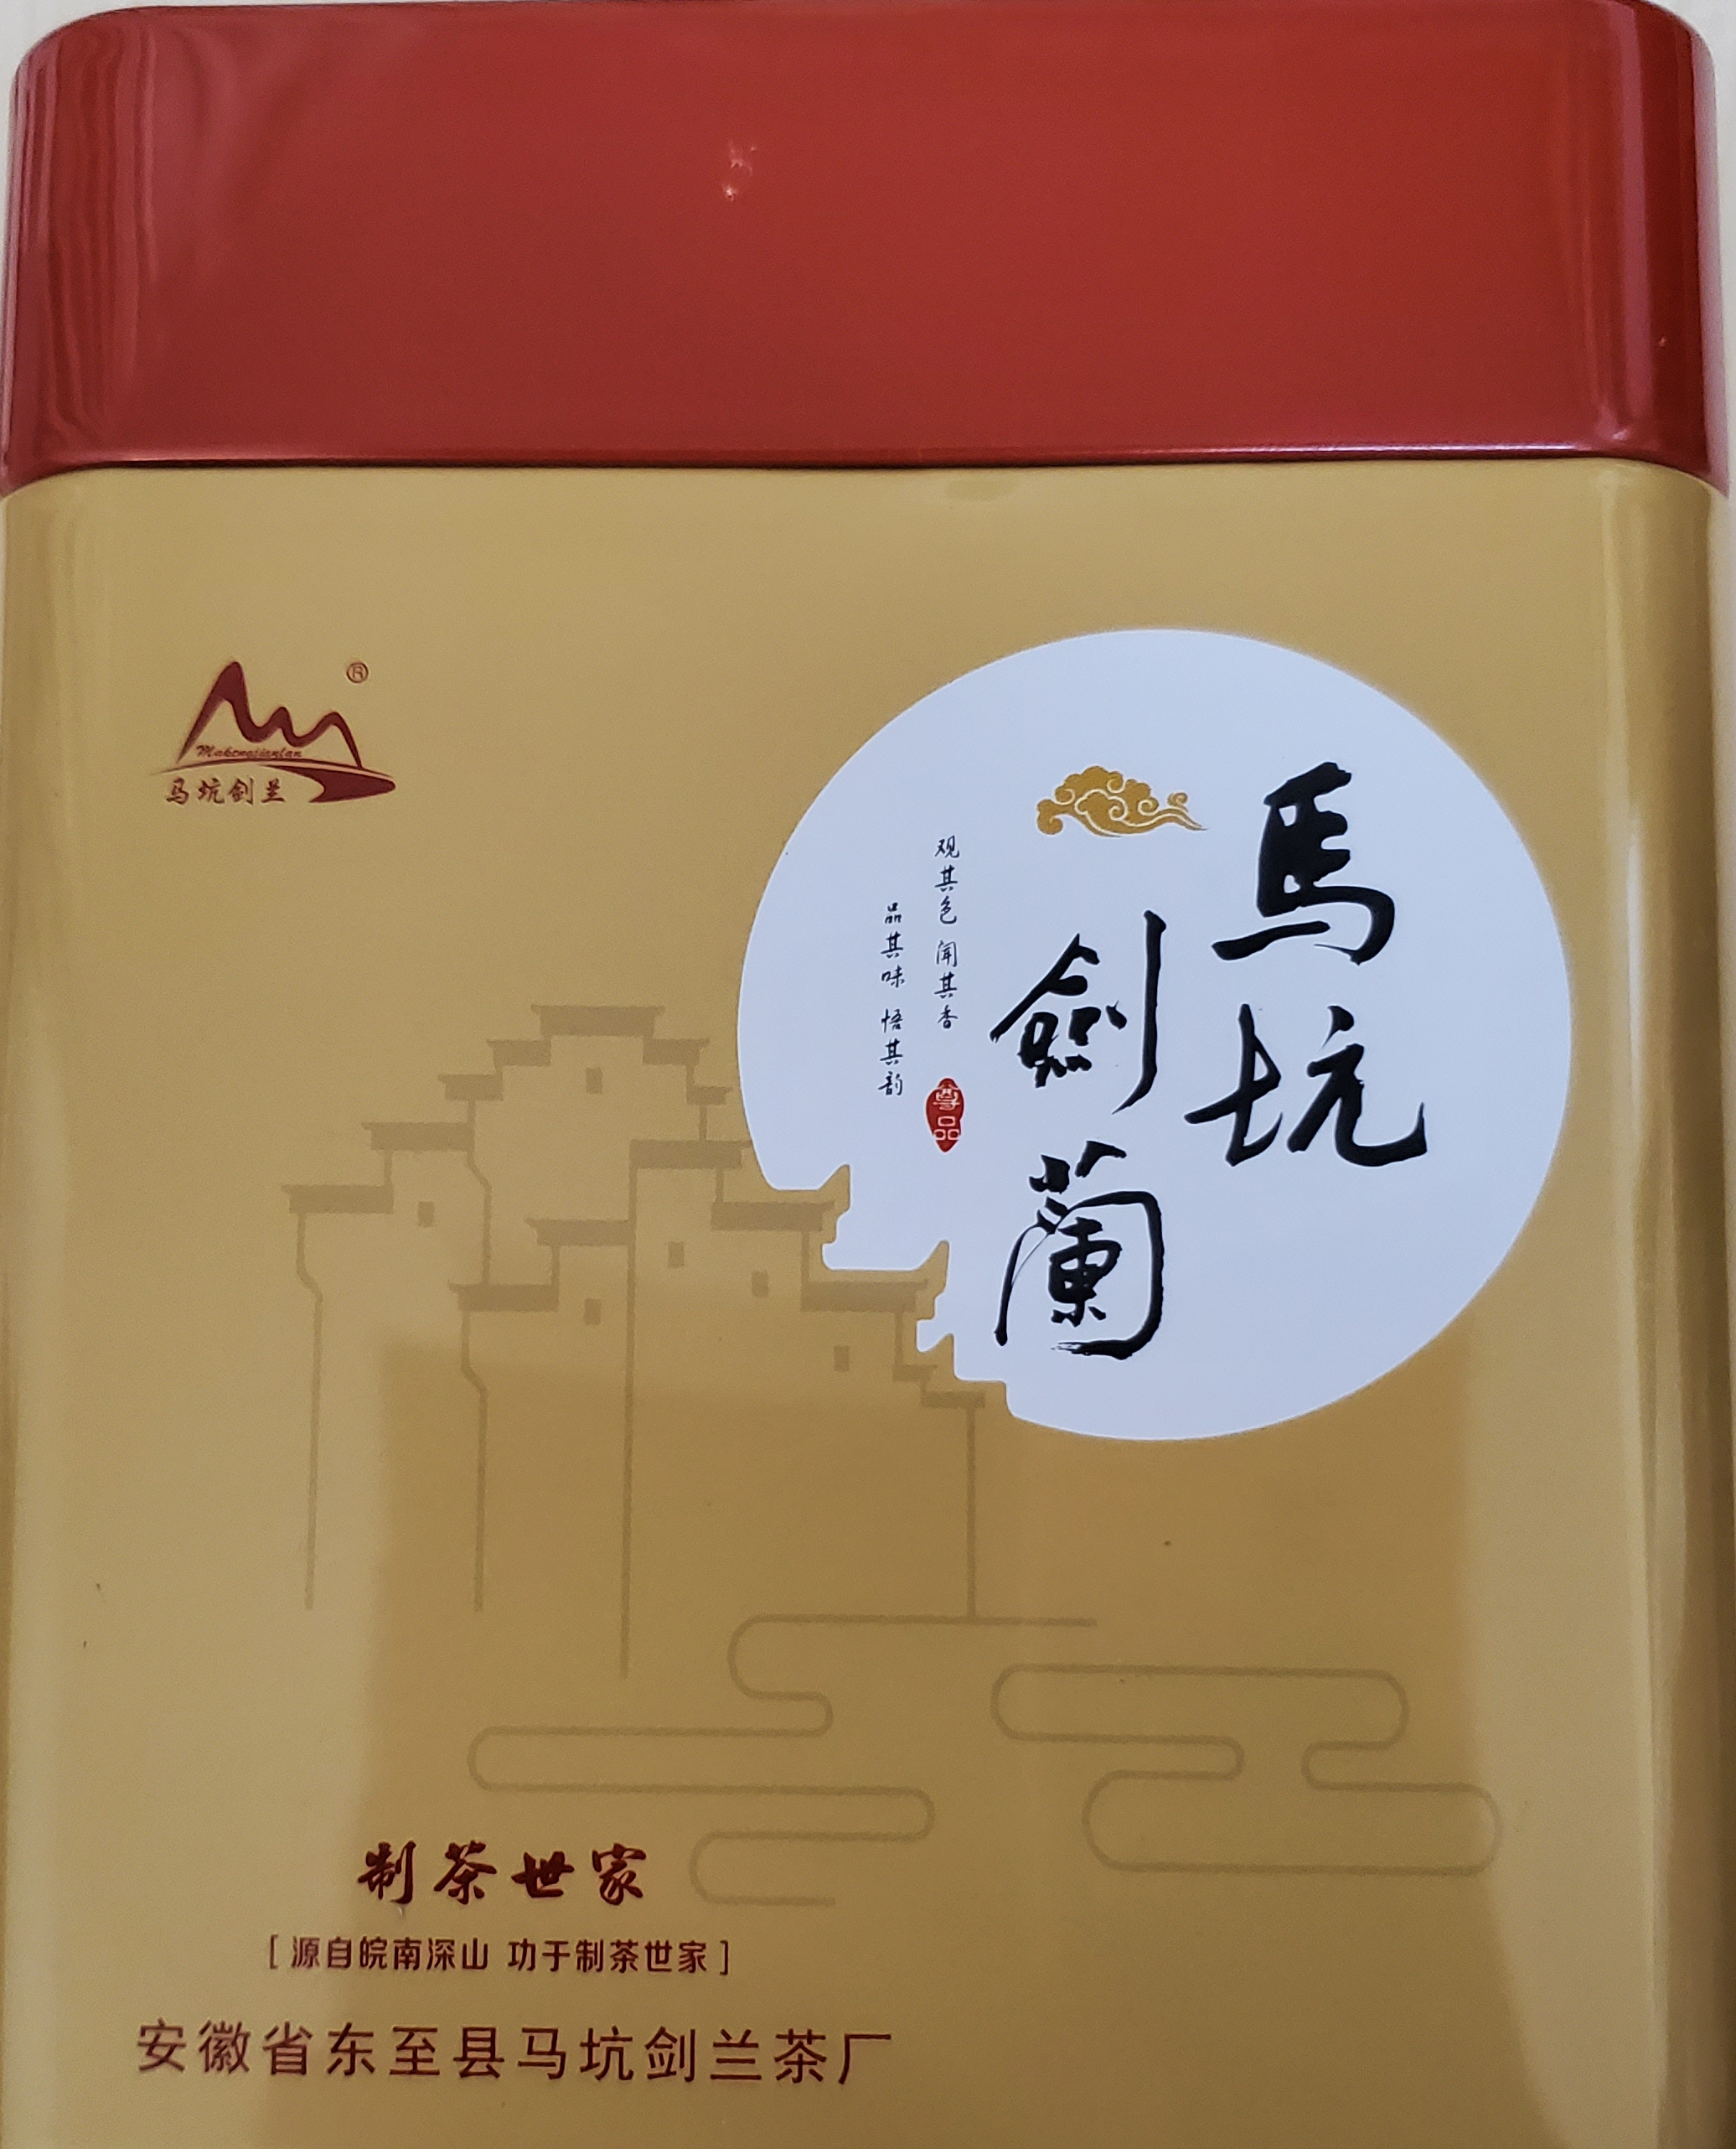
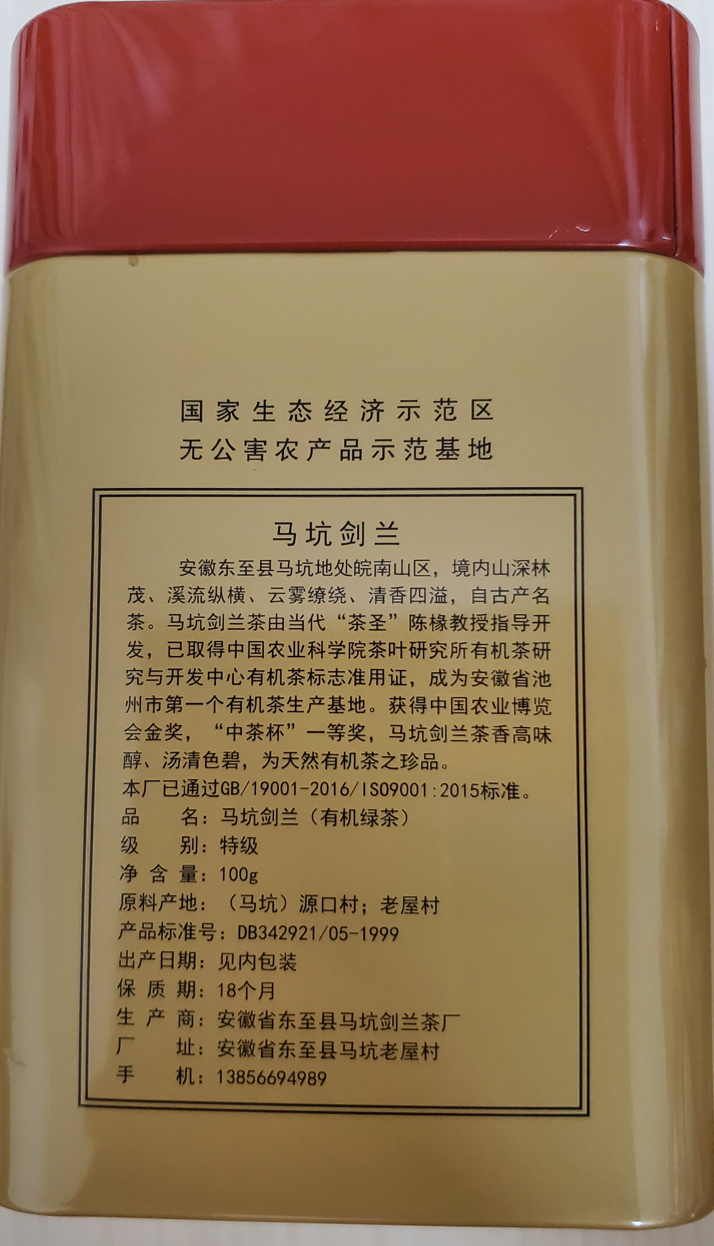
Example
This tea was made by a company that uses a quality management system specified in one of ISO standards
ISO9001:2015

Slide 88
ISO Standardization process
ISO has 804 technical committees and subcommittees concerned with standards development
International Standards are developed by ISO technical committees (TC) and subcommittees (SC) by a process with six steps
Stage 1: Proposal stage
Stage 2: Preparatory stage
Stage 3: Committee stage
Stage 4: Enquiry stage
Stage 5: Approval stage
Stage 6: Publication stage
As of April 2022, the ISO has developed over 24,261 standards, covering everything from manufactured products and technology to food safety, agriculture, and healthcare

Slide 89
Joint technical committee with IEC
ISO/IEC JTC 1
ISO has a joint technical committee (JTC) with the International Electrotechnical Commission (IEC) to develop standards relating to information technology

Slide 90
ISO/IEC JTC 1 Scope and mission
Develop, maintain, promote and facilitate IT standards required by global markets meeting business and user requirements concerning:
The design and development of IT systems and tools
The performance and quality of IT products and systems
The security of IT systems and information
The portability of application programs
The interoperability of IT products and systems
The unified tools and environments
The harmonized IT vocabulary
The user-friendly and ergonomically-designed user interfaces

Slide 91
ISO/IEC JTC 1 Structure
Most work on the development of standards is done by subcommittees (SCs), each of which deals with a particular field
Subcommittee dealing with the field of cloud computing is called ISO/IEC JTC 1/SC 38
Most of these subcommittees have several working groups (WGs)

Slide 92
Standardization of cloud computing

Slide 93
Standardization of cloud computing - definition
The implementation of standards in cloud computing industry

Slide 94
Why developing standards for the Cloud Computing?
Standards provide common communication protocols
Standards enable interoperability between various applications and infrastructures and consequently prevent the vendor lock-in
Standards help users to evaluate options and plan with confidence
Standards ensure data integrity, availability and confidentiality
Standards provide guidelines and good practices to improve security of cloud services
Standards support transparency and therefore build trust between cloud providers and cloud consumers

Slide 95
Where are technical standards developed?
Many standards and specifications related to Cloud Computing have been developed by standards developing organizations
These standards are developed within technical committees, with the aim to guide and propose solutions for all stakeholders involved in this technology, whether being cloud service providers, partners or customers

Slide 96
Where are technical standards developed?
At the international level, the three recognized standardization organizations are the:
International Organization for Standardization (ISO)
International Electrotechnical Commission (IEC)
International Telecommunication Union’s Telecommunication Standardization Sector (ITU-T)

Slide 97
Where are technical standards developed?
The main technical committees active in Cloud Computing standardization
ISO/IEC JTC 1/SC 38 “Cloud Computing and Distributed Platforms”
ITU-T/SG 13 “Future networks and emerging network technologies”
ISO/IEC JTC 1/SC 27 “Information security, cybersecurity and privacy protection”
ITU-T/SG 17 “Security”

Slide 98
Where are technical standards developed?
The main technical committees active in Cloud Computing standardization
ISO/IEC JTC 1/SC 38 “Cloud Computing and Distributed Platforms”
ITU-T/SG 13 “Future networks and emerging network technologies”
ISO/IEC JTC 1/SC 27 “Information security, cybersecurity and privacy protection”
ITU-T/SG 17 “Security”

Slide 99
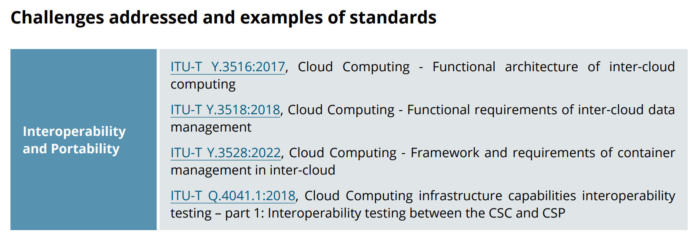
ITU-T/SG 13 “Future networks and emerging network technologies”

Slide 100
Where are technical standards developed?
The main technical committees active in Cloud Computing standardization
ISO/IEC JTC 1/SC 38 “Cloud Computing and Distributed Platforms”
ITU-T/SG 13 “Future networks and emerging network technologies”
ISO/IEC JTC 1/SC 27 “Information security, cybersecurity and privacy protection”
ITU-T/SG 17 “Security”

Slide 101
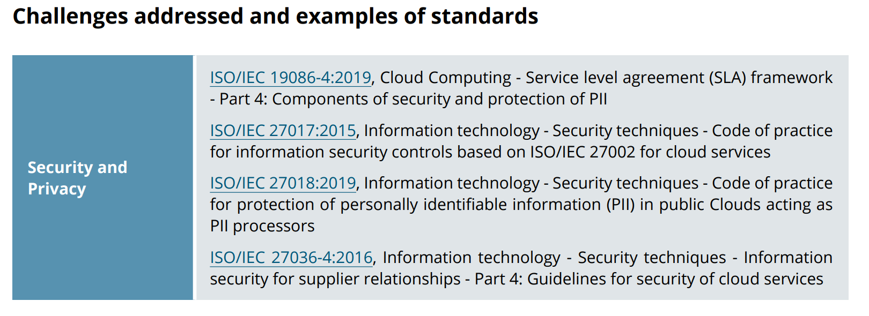
ISO/IEC JTC 1/SC 27 “Information security, cybersecurity and privacy protection”

Slide 102
Where are technical standards developed?
The main technical committees active in Cloud Computing standardization
ISO/IEC JTC 1/SC 38 “Cloud Computing and Distributed Platforms”
ITU-T/SG 13 “Future networks and emerging network technologies”
ISO/IEC JTC 1/SC 27 “Information security, cybersecurity and privacy protection”
ITU-T/SG 17 “Security”

Slide 103
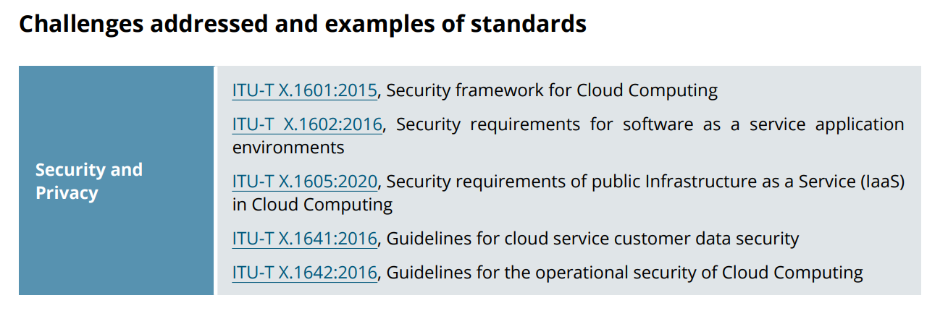
ITU-T/SG 17 “Security”

Slide 104
Where are technical standards developed?
The main technical committees active in Cloud Computing standardization
ISO/IEC JTC 1/SC 38 “Cloud Computing and Distributed Platforms”
ITU-T/SG 13 “Future networks and emerging network technologies”
ISO/IEC JTC 1/SC 27 “Information security, cybersecurity and privacy protection”
ITU-T/SG 17 “Security”

Slide 105
ISO/IEC JTC 1/SC 38 “Cloud Computing and Distributed Platforms”

Slide 106
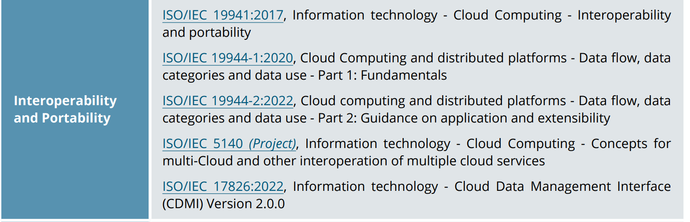
ISO/IEC JTC 1/SC 38 “Cloud Computing and Distributed Platforms”

Slide 107
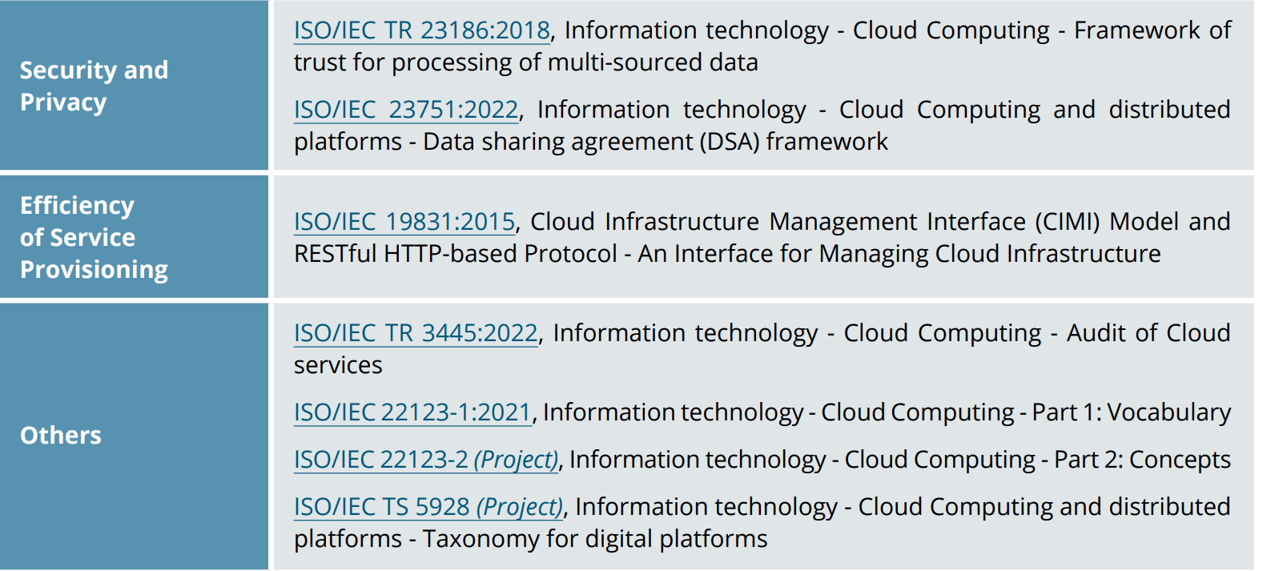
ISO/IEC JTC 1/SC 38 “Cloud Computing and Distributed Platforms”

Slide 108
ISO/IEC JTC 1/SC 38 “Cloud Computing and Distributed Platforms”
We will introduce the works of this subcommittee in more details

Slide 109
ISO/IEC JTC 1/SC 38
ISO/IEC JTC 1/SC 38 Cloud Computing and Distributed Platforms
A standardization subcommittee
Develops standards to assist organizations in specifying, acquiring and applying Cloud Computing and distributed platform technologies and services.

Slide 110
Member countries
29 participating members
Australia, Austria, Belgium, Brazil, Canada, China, Denmark, Finland, France, Germany, India, Ireland, Israel, Italy, Japan, Republic of Korea, Luxembourg, Netherlands, Poland, Portugal, Russian Federation, Singapore, Slovakia, South Africa, Spain, Sweden, Switzerland, United Kingdom, and United States of America
8 observing members
Argentina, Bosnia and Herzegovina, Czech Republic, Hong Kong, New Zealand, Norway, Serbia, and Uruguay

Slide 111
Scope and mission
The scope of ISO/IEC JTC 1/SC 38 is the “Standardization in the area of Cloud Computing and Distributed Platforms”.
Foundational concepts and technologies
Operational issues
Interactions among Cloud Computing systems and with other distributed systems

Slide 112
ISO/IEC JTC 1/SC 38 Structure
ISO/IEC JTC 1/SC 38 is made up of two working groups (WGs)
Each working group carries out specific tasks in standards development within the field of Cloud Computing and Distributed Platforms
Working Group | Working Area
ISO/IEC JTC 1/SC 38/WG 3 | Cloud Computing Fundamentals (CCF)
ISO/IEC JTC 1/SC 38/WG 5 | Cloud Computing Data and its Flow (CCDF)

Slide 113
WG 3 - CLOUD COMPUTING FUNDAMENTALS (CCF)
Cloud Computing Fundamentals (CCF)
Projects related to Cloud Computing Service Agreements
Projects related to fundamental concepts, terminology and definitions for Cloud Computing
Projects related to guidance on use of international standards in the development of policies that govern or regulate cloud service providers and cloud services, and policies that govern the use of cloud services in enterprise organizations
Establish liaisons and collaborate with other entities within JTC 1, SDOs and consortia performing work related to Cloud Computing

Slide 114
WG 5 – DATA IN CLOUD COMPUTING AND RELATED TECHNOLOGIES
Cloud Computing Data and its Flow (CCDF)
Standardization in the area of data in cloud computing, distributed platforms, connected devices and related technologies
Establish liaisons and collaborate with other entities within and external to JTC 1 as appropriate

Slide 115
Standards developed by ISO/IEC JTC 1/SC 38
ISO/IEC JTC 1/SC 38 published many standards in the area of
Cloud Computing
Web Services
Service Oriented Architecture (SOA)

Slide 116
Standards developed by ISO/IEC JTC 1/SC 38
ISO/IEC JTC 1/SC 38 has 15 published standards in the area of
Cloud Computing
Web Services
Service Oriented Architecture (SOA)

Slide 117
ISO/IEC 17203
Information technology — Open Virtualization Format (OVF) specification
Specifies an open, secure, portable, efficient and extensible format for the packaging and distribution of software to be run in virtual machines

Slide 118
ISO/IEC 17788
Information technology -- Cloud computing -- Overview and vocabulary
Provides an overview of cloud computing along with a set of terms and definitions

Slide 119
ISO/IEC 17789
Information technology — Cloud computing — Reference architecture
Specifies the cloud computing reference architecture (CCRA)
cloud computing roles
cloud computing activities
cloud computing functional components and their relationships

Slide 120
ISO/IEC 17826
Information technology – Cloud Data Management Interface (CDMI)
Specifies the interface to access cloud storage and to manage the stored data

Slide 121
ISO/IEC 19086-1
Information technology — Cloud computing — Service level agreement (SLA) framework — Part 1: Overview and concepts
Establishes a set of common cloud SLA building blocks (concepts, terms, definitions, contexts) that can be used to create cloud Service Level Agreements (SLAs).

Slide 122
ISO/IEC 19086-2
Cloud computing — Service level agreement (SLA) framework — Part 2: Metric model
Establishes common terminology, defines a model for specifying metrics for cloud SLAs, and includes applications of the model with examples.

Slide 123
ISO/IEC 19086-3
Information technology — Cloud computing — Service level agreement (SLA) framework — Part 3: Core conformance requirements
Specifies the core conformance requirements for service level agreements (SLAs) for cloud services based on ISO/IEC 19086‑1 and guidance on the core conformance requirements.

Slide 124
ISO/IEC 19941
Information technology — Cloud computing — Interoperability and portability
Specifies cloud computing interoperability and portability types, the relationship and interactions between these two cross-cutting aspects of cloud computing and common terminology and concepts used to discuss interoperability and portability, particularly relating to cloud services.

Slide 125
ISO/IEC 19944
Information technology — Cloud computing — Cloud services and devices: Data flow, data categories and data use
Extends the existing cloud computing vocabulary and reference architecture in ISO/IEC 17788 and ISO/IEC 17789 to describe an ecosystem involving devices using cloud services

Slide 126
ISO/IEC TR 22678
Information technology — Cloud computing — Guidance for policy development
Provides guidance on the use of international standards as a tool in the development of those policies that govern or regulate cloud service providers (CSPs) and cloud services, and those policies and practices that govern the use of cloud services in organisations.

Slide 127
ISO/IEC TR 23186
Information technology — Cloud computing — Framework of trust for processing of multi-sourced data
Describes a framework of trust for the processing of multi-sourced data that includes data use obligations and controls, data provenance, chain of custody, security and immutable proof of compliance as elements of the framework.

Slide 128
Standards developed by ISO/IEC JTC 1/SC 38
ISO/IEC JTC 1/SC 38 has 15 published standards in the area of
Cloud Computing
Web Services
Service Oriented Architecture (SOA)

Slide 129
ISO/IEC 17963
Web Services for Management (WS-Management) Specification
Describes a Web services protocol based on SOAP for use in management‑specific domains

Slide 130
Standards developed by ISO/IEC JTC 1/SC 38
ISO/IEC JTC 1/SC 38 has 15 published standards in the area of
Cloud Computing
Web Services
Service Oriented Architecture (SOA)

Slide 131
ISO/IEC 17998
Information technology – SOA Governance Framework
Describes a framework for providing context and definitions related to SOA for organizations to use when deploying SOA governance.
Defines:
SOA Governance
SOA Governance Reference Model
SOA Governance Vitality Model

Slide 132
ISO/IEC 18384-1
Information technology — Reference Architecture for Service Oriented Architecture (SOA RA) — Part 1: Terminology and concepts for SOA
Establishes vocabulary, guidelines, and general technical principles underlying service oriented architecture (SOA), including principles relating to functional design, performance, development, deployment, and management.

Slide 133
ISO/IEC 18384-1
Information technology — Reference Architecture for Service Oriented Architecture (SOA RA) — Part 1: Terminology and concepts for SOA
Establishes vocabulary, guidelines, and general technical principles underlying service oriented architecture (SOA), including principles relating to functional design, performance, development, deployment, and management.

Slide 134
ISO/IEC 18384-2
Information technology — Reference Architecture for Service Oriented Architecture (SOA RA) — Part 2: Reference Architecture for SOA Solutions
Describes a Reference Architecture for SOA Solutions which applies to functional design, performance, development, deployment and management of SOA Solutions.

Slide 135
ISO/IEC 18384-3
Information technology — Reference Architecture for Service Oriented Architecture (SOA RA) — Part 3: Service Oriented Architecture ontology
Defines a formal ontology for service-oriented architecture (SOA), an architectural style that supports service orientation. The terms defined in this ontology are key terms from the vocabulary in ISO/IEC 18384-1.

Slide 136
ISO/IEC TR 30102
Information technology – Distributed Application Platforms and Services (DAPS) – General technical principles of Service Oriented Architecture
Describes general technical principles underlying SOA including principles relating to functional design, performance, development, deployment and management

Slide 137
Collaborations (1)
SO/IEC JTC 1/SC 38 subcommittee works closely with a number of other JTC 1 subcommittees
ISO/IEC JTC 1/SC 7, Software and Systems Engineering
ISO/IEC JTC 1/SC 27, IT Security Techniques
…

Slide 138
Collaborations (2)
SO/IEC JTC 1/SC 38 subcommittee works with a number of external forums
Cloud Security Alliance
Distributed Management Task Force (DMTF)
Open Grid Forum
Open Group
IEEE Computer Society
…

Slide 139
Collaborations (3)
ISO/IEC JTC 1/SC 38 (specifically WG 3: Cloud Computing) and ITU-T/SG 13 formed collaborative teams
Collaborative Team on Cloud Computing Overview and Vocabulary (CT-CCVOCAB)
developed standard ISO/IEC JTC 1 17788 – Cloud Computing Vocabulary
Collaborative Team on Cloud Computing Reference Architecture (CT-CCRA)
developed standard ISO/IEC JTC 1 17789 – Cloud Computing Reference Architecture

Slide 140
Importance of foundational standards
Two foundational standards that deal with vocabulary and reference architecture
ISO/IEC 17788:2014 “Information technology — Cloud computing — Overview and vocabulary”
ISO/IEC 17789:2014 “Information technology — Cloud computing — Reference architecture”.
Essential for developing other standards

Slide 141
Importance of foundational standards
Two foundational standards that deal with vocabulary and reference architecture
ISO/IEC 17788:2014 “Information technology — Cloud computing — Overview and vocabulary”
ISO/IEC 17789:2014 “Information technology — Cloud computing — Reference architecture”.
Essential for developing other standards

